Slide 1


EXTRACT CRITICAL BUSINESS INSIGHTS FROM WALMART SALES DATA

Slide 2
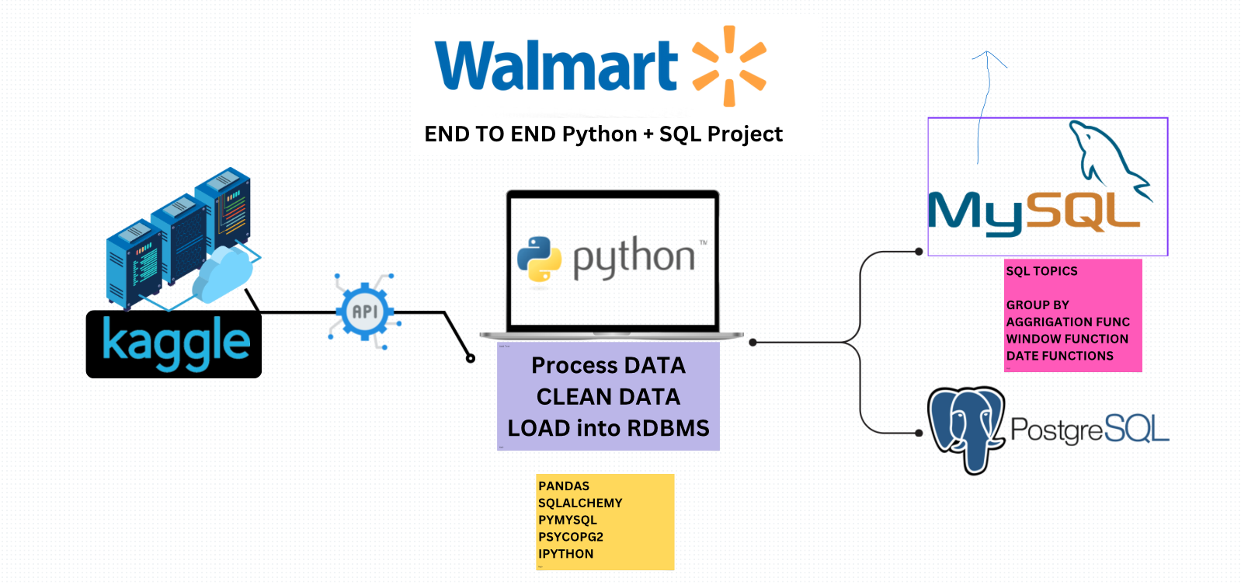










Project pipeline

Slide 3
Project Steps
# Download Walmart Sales Data:
Data Source :
Use the Kaggle API to download the Walmart sales datasets from Kaggle.
Dataset Link :
Walmart Sales Dataset
Storage :
Save the data in the data/ folder for easy reference and access.
# Install Required Libraries and Load Data:
Libraries :
Install necessary Python libraries.
Loading Data :
Read the data into a Pandas Data Frame for initial analysis and transformations.

Slide 4
Project Steps
# Explore the Data:
Goal :
Conduct an initial data exploration to understand data distribution, check column names,
types, and identify potential issues..
Analysis:
Use functions like .info(), .describe(), and .head() to get a quick overview of the data
structure and statistics.
# Data Cleaning
Remove Duplicates:
Identify and remove duplicate entries to avoid skewed results.
Handle Missing Values:
Drop rows or columns with missing values if they are
insignificant; fill values where essential.
Fix Data Types:
Ensure all columns have consistent data types (e.g., dates as datetime, prices as float).
Currency Formatting:
Use .replace() to handle and format currency values for analysis.

Slide 5
Project Steps
# Feature Engineering:
Create New Columns :
Calculate the Total Amount for each transaction by multiplying unit_price
by quantity and adding this as a new column.
Enhance Dataset:
Adding this calculated field will streamline further SQL analysis and aggregation tasks.
# Load Data into MySQL :
Create database , Load the cleaned data into database.
# SQL Analysis :
Complex Queries , Subqueries , CTEs , Windows function

Slide 6
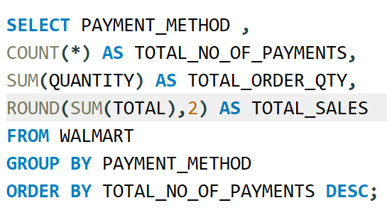
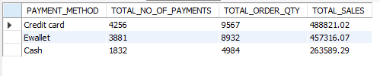
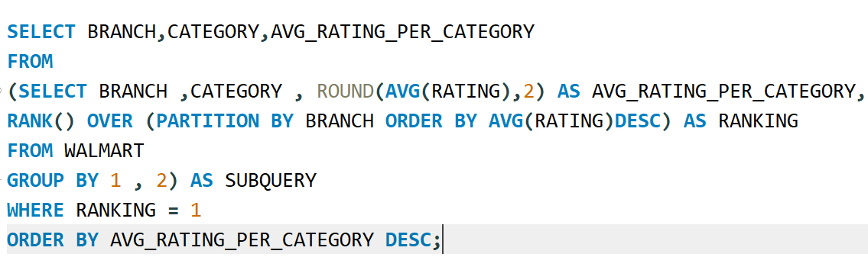
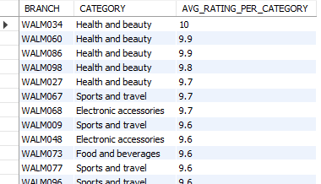
SQL Analysis
MOST PREFERENCE PAYMENT MODE, TOTAL SALES & TOTAL QUANTITY
HIGHEST AVG RATING CATEGORY BRACH WISE

Slide 7
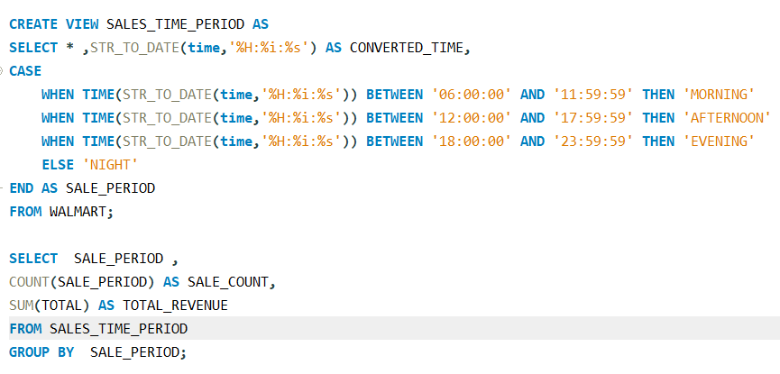
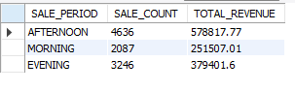
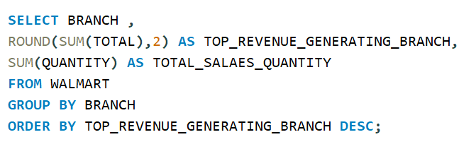
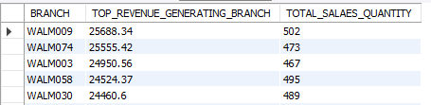
SQL Analysis
ANALYZE SALES SHIFTS THROUGHOUT THE DAY
HIGHEST REVENUE GENERATING BRANCH WITH TOTAL QUANTITY SALE

Slide 8
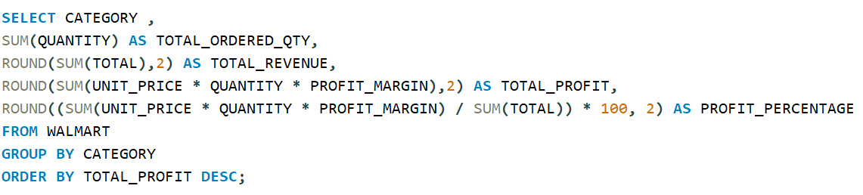
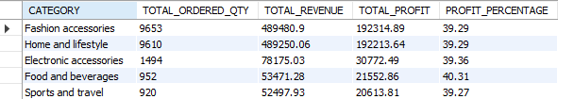
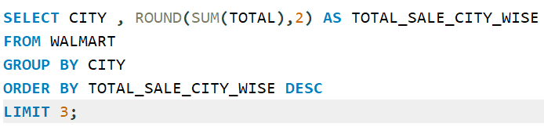
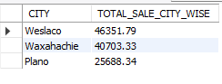
SQL Analysis
EACH CATEGORY TOTAL QUANTITY SALE ,TOTAL REVENUE AND PROFIT
TOP REVENUE GENERATING CITIES

Slide 9
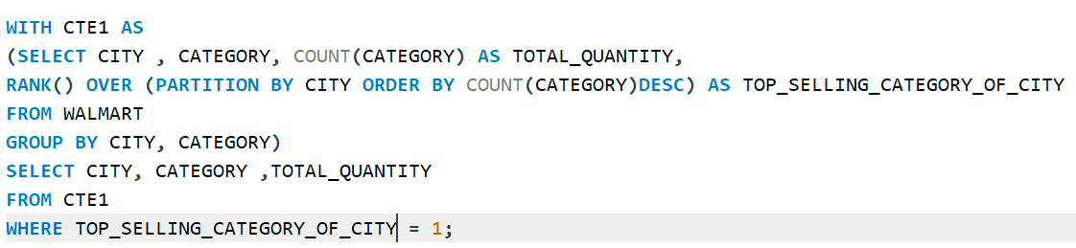
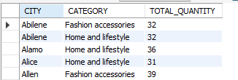
SQL Analysis
TOP SELLING CATEGORY OF EACH CITY

Slide 10
Results and Insights
Sales Insights:
Key categories, branches with highest sales, and
preferred payment methods.
Profitability:
Key categories, branches with highest sales, and preferred
payment methods.
Customer Behavior :
Trends in ratings, payment preferences, and peak
shopping hours.

